Slide 1
Art Gallery
Mister Freeze Group
Team Member:
Bingyue Zeng
Xuejun Shen
Xiao Xue
Zengpu Wang

Slide 2
Abstract
Entity Relationship Diagram
Normalized Relational Model
Two Tables with Data
Four Queries
Surprise item

Slide 3
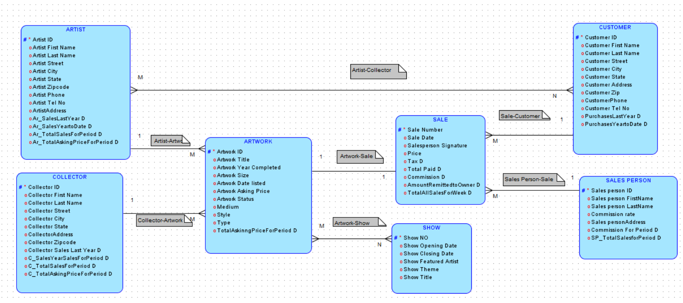
Entity Relationship Diagram

Slide 4
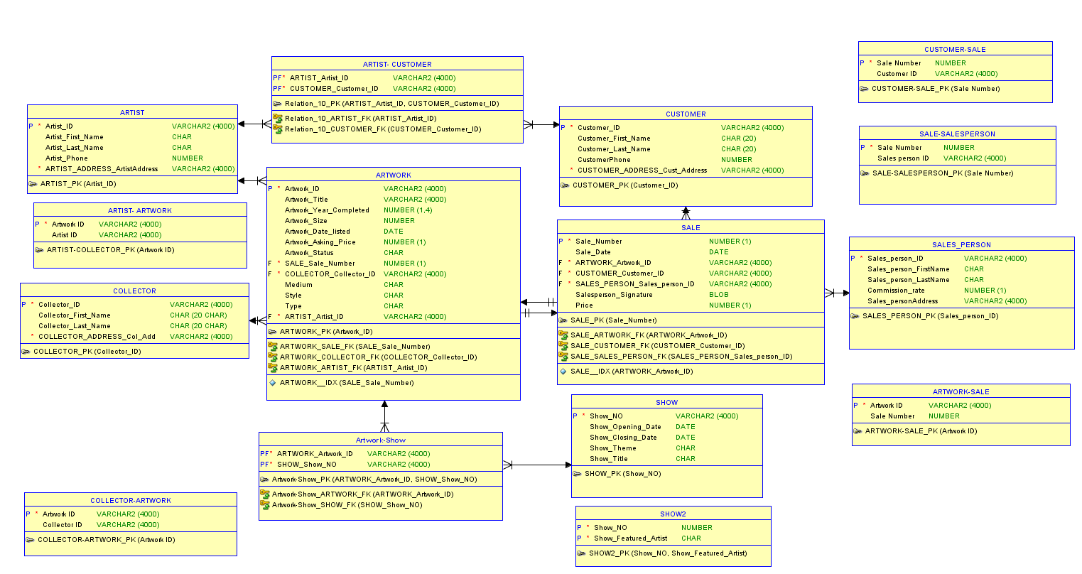
Normalized Relational Model

Slide 5
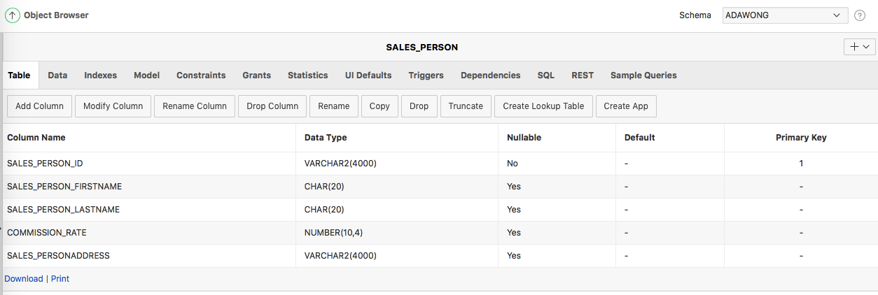
Table1: Salesperson Table Structure

Slide 6
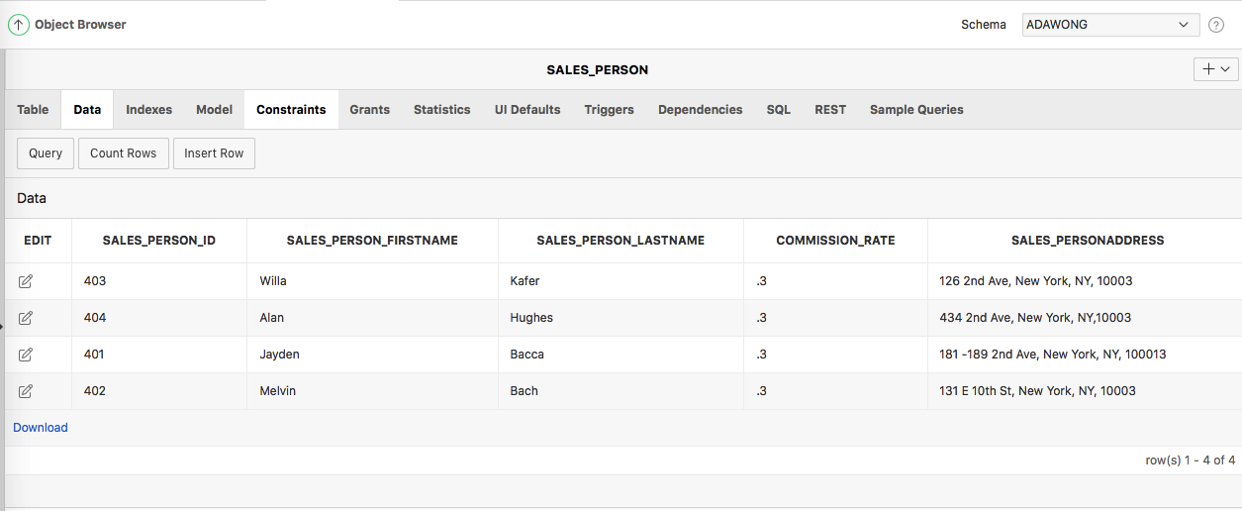
Table1: Salesperson Table with Data

Slide 7
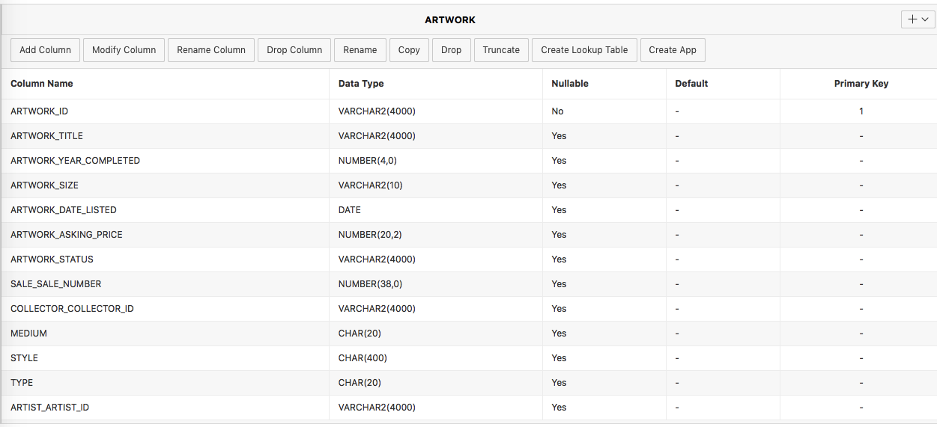
Table 2: Artwork Table Structure

Slide 8
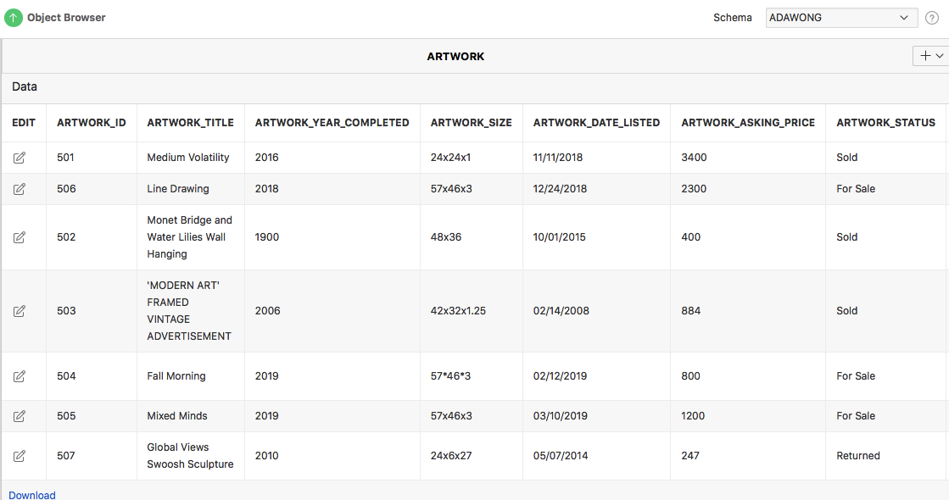
Table2: Artwork Table with Data

Slide 9
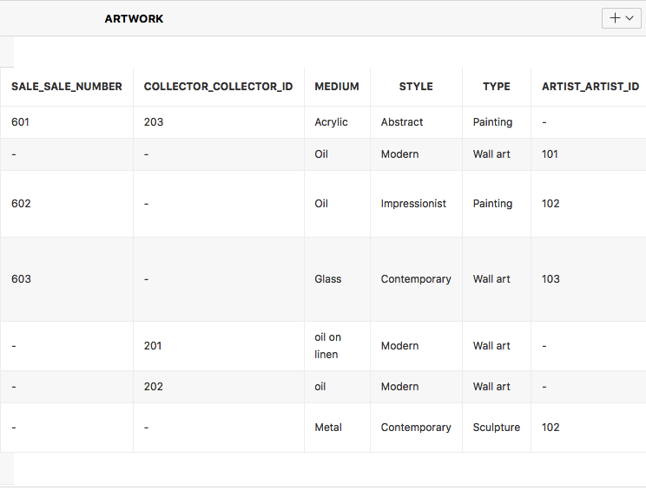
Table2: Artwork Table with Data Continued

Slide 10
Query 1: Give commissions and related sales of salespersons
SQL Version:
Select SALES_PERSON.SALES_PERSON_FIRSTNAME||' '||SALES_PERSON.SALES_PERSON_LASTNAME
as Salesperson_Name, sale.SALE_NUMBER,SALES_PERSON.COMMISSION_RATE,
sale.price* SALES_PERSON.COMMISSION_RATE as Commission
From sale,SALES_PERSON
Where SALES_PERSON.SALES_PERSON_ID=sale.SALES_PERSON_SALES_PERSON_ID

Slide 11
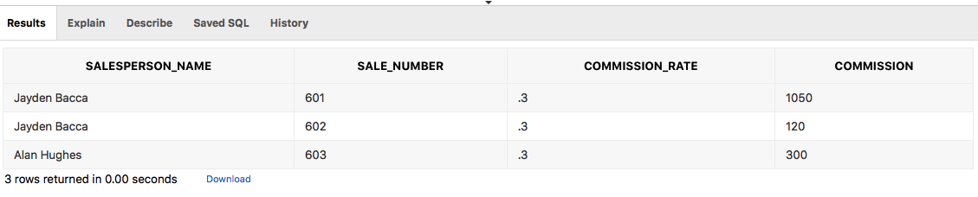
Query 1: Output

Slide 12
Query 2: Give artwork information including title, asking price and medium and their related artist name
SQL Version:
select artwork_title, artwork_asking_price, medium, artist.artist_first_name||' '||artist.artist_last_name
as artist_name from ARTWORK, ARTIST
where artist.artist_ID=artwork.artist_artist_ID
order by artwork_asking_price desc

Slide 13
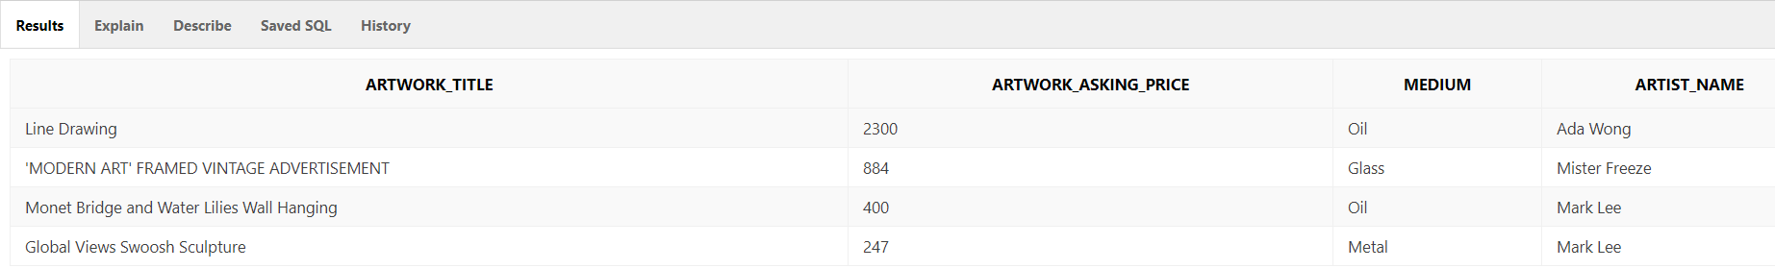
Query 2: Output

Slide 14
Query 3:Show the information of artwork which is owned by artist and completed after 2000
SQL Version:
SELECT ARTIST.ARTIST_ID,ARTWORK.ARTWORK_ID,ARTWORK.Artwork_Title, ARTWORK.Artwork_Year_Completed,SALE.PRICE
FROM ARTIST, ARTWORK,SALE
WHERE ARTWORK.Artwork_Year_Completed > 2000 AND ARTIST.Artist_ID = ARTWORK.ARTIST_ARTIST_ID AND ARTWORK.SALE_SALE_NUMBER = SALE.SALE_NUMBER

Slide 15
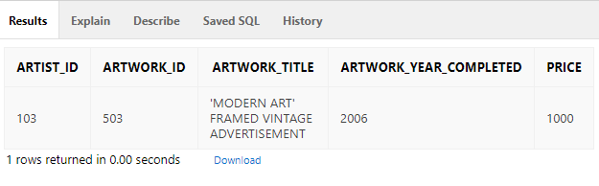
Query 3: Output

Slide 16
Query 4: Who owns the artwork? Is he or her an artist or a collector? Each full name, and address.
SQL Version:
Select artwork_title, artist_first_name || artist_last_name as Artist_Name, ARTIST_ADDRESS_ARTISTADDRESS as Artist_Address, collector_first_name || collector_last_name as Collector_Name, COLLECTOR_ADDRESS_COL_ADD as Collector_Addresss
From artwork
left join artist
on artist.artist_id = artwork.artist_artist_id
left join collector
on collector.COLLECTOR_ID = artwork.COLLECTOR_COLLECTOR_ID

Slide 17
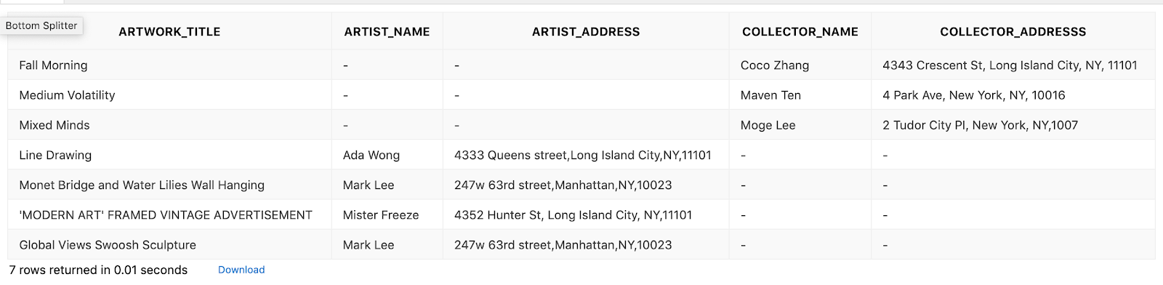
Query 4: Output

Slide 18
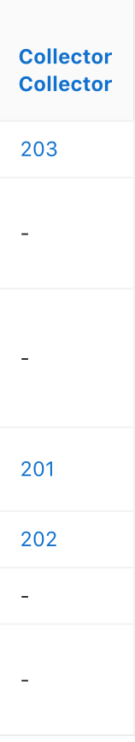
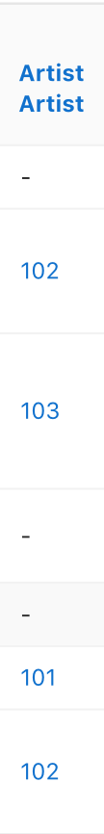
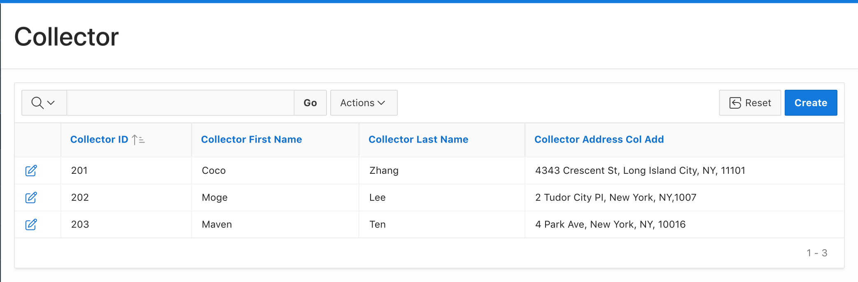
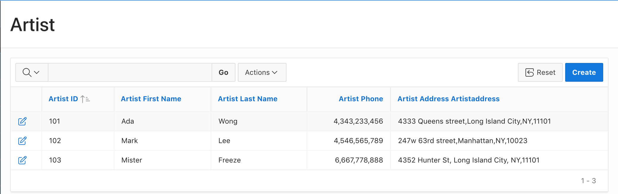
Surprise Item
Create Link : either to page in this application
Or to external url

Slide 19
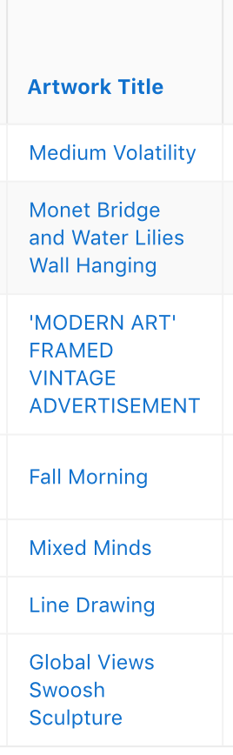


Slide 20
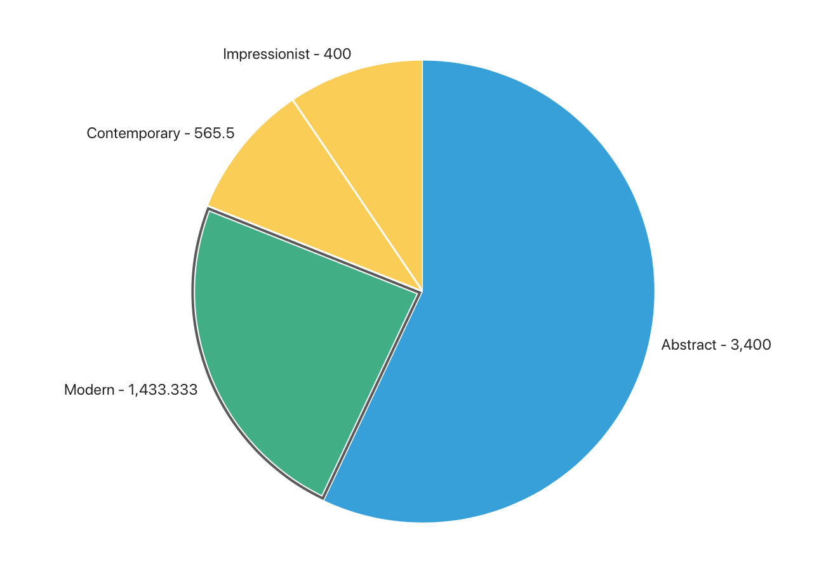
Simple Visualization
To check the average price listed for each artwork style:
Action → Chart → Pie Chart → Label: Style, Value: Artwork asking price, Function: Average.

Slide 21
Question?

